Slide 1

Thunderbird

Slide 2
Thunderbird Features
Easier to get started
Tab and search
Customize your email experience
Secure and protect your email

Slide 3
Easier to get started
Mail account set-up wizard
One click address book
Attachment reminder

Slide 4
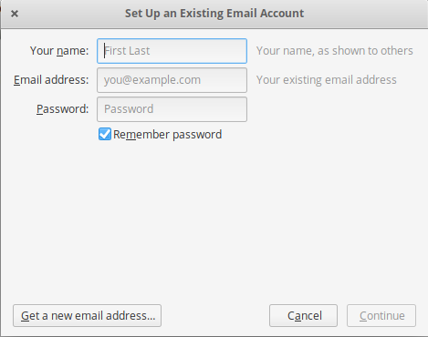
Mail Account Set-Up Wizard

Slide 5
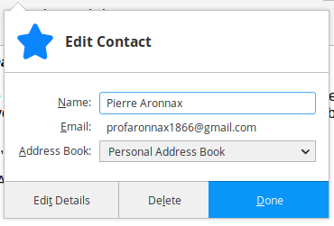
One Click Address Book

Slide 6
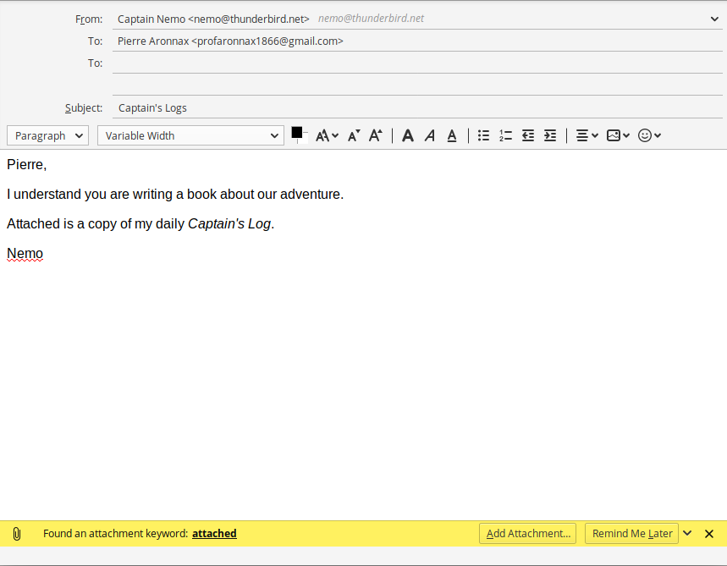
Attachment Reminder

Slide 7
Tabs and search
Can have multiple emails open simultaneously
Quick filter search
Search tools
Message archive

Slide 8
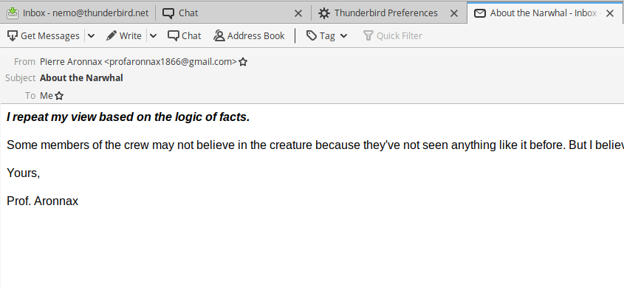
Have Multiple Emails Open

Slide 9
Quick Filter Search
The Quick Filter Toolbar lets you filter your email faster.
Start typing in words in the Quick Filter search box and the results are displayed instantly.

Slide 10
Search Tools
The search interface in Thunderbird contains filtering and timeline tools to pinpoint the exact email you’re looking for.
Thunderbird also indexes all of your emails and chat conversations to help you search even faster.
Your search results are displayed in a tab so you can easily switch back and forth to your search results and other email.

Slide 11
Message Archive
If you think you’re going to need an email in the future but want it out of your inbox without deleting it, archive it!
The use of tags can also assist.

Slide 12
Customize your email experience
Large files management
Thunderbird look and feel
Smart folders
Add-ons manager

Slide 13
Large Files Management
You can now speed up the transfer of large documents by uploading them to an online storage provider and sharing the link instead of sending the file directly as a message attachment.
Configure in preferences.

Slide 14
Thunderbird Look And Feel
Themes allow you to change the look of Thunderbird in an instant.
Thunderbird ships with both light and dark themes.

Slide 15
Smart Folders
Smart Folders help you manage multiple email accounts by combining special folders like your Inbox, Sent, or Archive folder.
Configure in account settings

Slide 16
Add-ons Manager
Find and install add-ons directly in Thunderbird.
You no longer need to visit the add-ons Web site - instead simply open the Add-ons Manager (in preferences)

Slide 17
Secure and protect your email
Robust privacy
Phishing protection
Automated update
Cutting out the junk
Open source

Slide 18
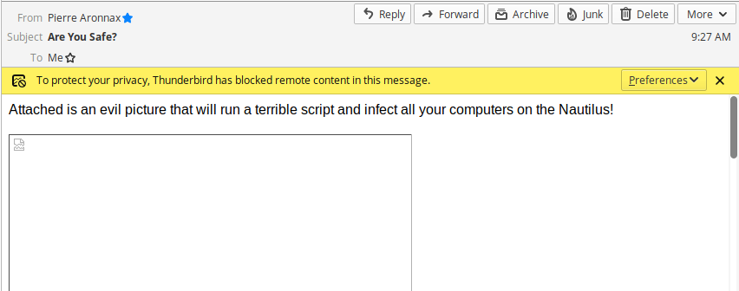
Robust Privacy

Slide 19
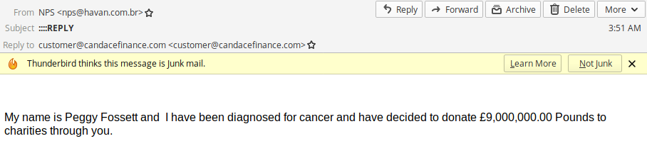
Phishing Protection

Slide 20
Automated Update
Thunderbird’s update system checks to see if you’re running the latest version, and notifies you when a security update is available.
When Thunderbird is installed by default your computer OS takes care of this task

Slide 21
Cutting Out The Junk
Thunderbird’s popular junk mail tools have been updated to stay ahead of spam.
Each email you receive passes through Thunderbird’s leading-edge junk mail filters.
Each time you mark messages as spam, Thunderbird "learns" and improves its filtering so you can spend more time reading the mail that matters.

Slide 22
Open Source
At the heart of Thunderbird is an open source development process driven by thousands of passionate, experienced developers and security experts spread all over the world.

